Slide 1
Compensation Philosophy, Objectives, and Implementation
Faculty Welfare Committee
CFA open meeting
February 27th, 2018

Slide 2
Compensation Philosophy

Slide 3
Compensation Philosophy
Across the college
Faculty salary will always be at least as high as the currently established college threshold wage in rank.
This threshold wage will be incremented each year to maintain purchasing power, reflecting our core LaSallian commitment to compensation that supports a faculty that is engaged in a productive life as teacher-scholar in the NYC metropolitan area.
There is a shared commitment to salary progression but the pace of such increases are subject to the College’s fiscal realities.
Within each discipline
We will endeavor to offer competitive salaries tethered to our benchmark salaries by discipline and rank.
The aim is to enable the College to both attract and retain an excellent faculty in the professional disciplines.
Promotional increases will be established to support this aim.

Slide 4
Compensation Philosophy (cont’d)
Manhattan College’s approach to faculty compensation will prioritize the across the board annual increase.
Annual raises should function to move individual faculty members to higher percentiles of the salary range based on time in rank and discipline.
Attainment of these ranges and their timing depends on the financial situation of the College.

Slide 5
Compensation Objectives
Salary Determination
Threshold Wage
Salary Progression
Annual Increase
Promotions

Slide 6
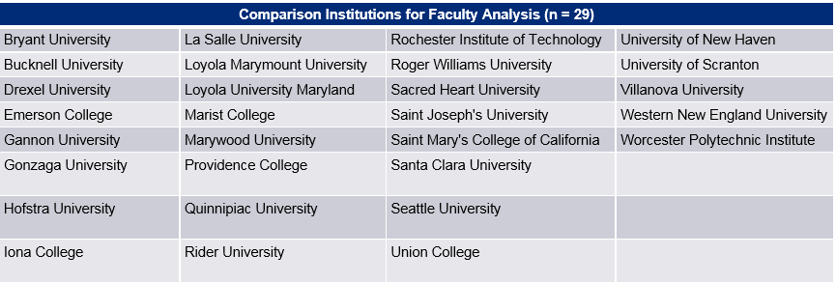
1. Salary Determination
Salary determination will consistently use College and University Professional Association for Human Resources (CUPA-HR) data from the benchmark list by rank and discipline (or closest equivalent.)

Slide 7
2. Threshold Wage
At a minimum, salary will be hired and promoted to the 25th percentile of their rank and discipline, or at the existing college threshold wage by rank, whichever is highest.
The existing college threshold wages by rank will increase annually according to the average annual increase in the 25th percentile salary ranges from our benchmark list.

Slide 8
3. Salary Progression
For each rank and discipline, compensation ranges have been proposed.
If the fiscal situation at the college remains strong, salaries should progress through these ranges at a predictable rate.
These ranges will not be lower than the 25th percentile for any rank and discipline, but for disciplines with medians close to our threshold wage, the above ranges have been expanded by a formula that also tethers the ranges to CUPA-HR data.
Throughout the range, salaries will be stratified proportionately, by discipline and time in rank. These targets are subject to and will be continually reviewed against the financial standing of the college.
For each discipline, the salary targets are:
10 years to median, with proportional stratification throughout range.
20 years to 75th percentile, with proportional stratification throughout range.

Slide 9
4. Annual Increase
This remains the highest priority.
The annual increase has two components:
The baseline component is the annual increase in the salary ranges (25-75% of the median of our reference group and currently at 2.5%)*.
The second component is based on a calculation of the average increase required to bring the key disciplines** to the 50th percentile of the Mercer ranges over a ten-year period.
* These figures will be updated and published annually. They will also be measured regularly against CUPA-HR data from our reference schools by the administrative leadership and FWC.
** Twelve key disciplines have been identified. Their salaries are lowest relative to our reference group. They are: Accounting; Chemical Engineering; Civil and Environmental Engineering; Computer Information Systems; Computer Science; Economics; Finance; Law; Management; Marketing; and Mechanical Engineering.

Slide 10
5. Promotions
Faculty will receive whichever of the following three is greatest:
$8,000 for promotion to associate and $10,000 for promotion to professor.
The threshold wage of their new rank.
The 25th percentile of their new rank in their discipline.

Slide 11
Salary Ranges and Market Data
Please Note that all these data are of last year, and do not account for the current baseline increase.
Salary increase should be through the mercer ranges, which are tied to but not necessarily equal to the ranges.

Slide 12
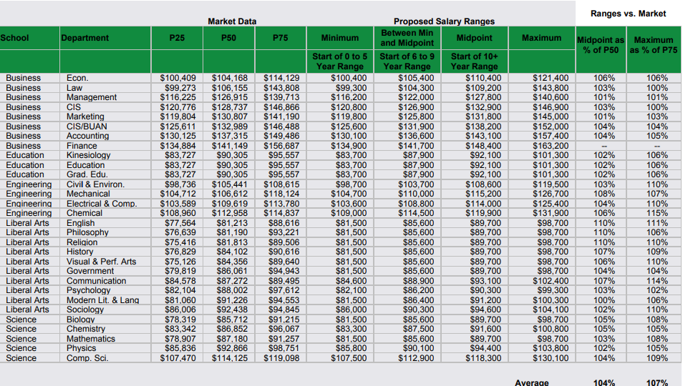
Associate Professor Salary Ranges (2016-2017)

Slide 14
Associate Professor Salary Ranges: School of Business (2016-2017)
Department | Market Data ($) |  |  | Proposed Salary Ranges ($)
 | 25th percentile | 50th percentile | 75th percentile | Min. (0-5 yrs) | Between Min. and Midpoint (6-5 yrs) | Midpoint (10+yrs) | Max.
Economics | 100,409 | 104,168 | 114,129 | 100,400 | 105,400 | 110,400 | 121,400
Law | 99,273 | 106,155 | 143,808 | 99,300 | 104,300 | 109,200 | 143,800
CIS | 120,776 | 128,737 | 146,866 | 120,800 | 126,900 | 132,900 | 146,900
Marketing | 119,804 | 130,807 | 141,190 | 119,800 | 125,800 | 131,800 | 145,000
CIS/BUAN | 125,611 | 132,989 | 146,488 | 125,600 | 131,900 | 138,200 | 152,000
Accounting | 130,125 | 137,315 | 149,486 | 130,100 | 136,600 | 143,100 | 157,400
Finance | 134,884 | 141,149 | 156,687 | 134,900 | 141,700 | 148,400 | 163,200
Management | 116,225 | 126,915 | 139,713 | 116,200 | 122,000 | 127,800 | 140,600

Slide 15
Associate Professor Salary Ranges: School of Education (2016-2017)
Department | Market Data ($) |  |  | Proposed Salary Ranges ($)
 | 25th percentile | 50th percentile | 75th percentile | Min. (0-5 yrs) | Between Min and Midpoint (6-5 yrs) | Midpoint (10+yrs) | Max.
Kinesiology | 83,727 | 90,305 | 95,557 | 83,700 | 87,900 | 92,100 | 101,300
Education | 83,727 | 90,305 | 95,557 | 83,700 | 87,900 | 92,100 | 101,300
Grad. Edu. | 83,727 | 90,305 | 95,557 | 83,700 | 87,900 | 92,100 | 101,300

Slide 16
Associate Professor Salary Ranges: School of Engineering (2016-2017)
Department | Market Data ($) |  |  | Proposed Salary Ranges ($)
 | 25th percentile | 50th percentile | 75th percentile | Min. (0-5 yrs) | Between Min and Midpoint (6-5 yrs) | Midpoint (10+yrs) | Max.
Civil & Environ. | 98,736 | 105,441 | 108,615 | 98,700 | 103,700 | 108,600 | 119,500
Mechanical | 104,712 | 106,612 | 118,124 | 104,700 | 110,000 | 115,200 | 126,700
Electrical & Comp. | 103,589 | 109,619 | 113,780 | 103,600 | 108,800 | 114,000 | 125,400
Chemical | 108,960 | 112,958 | 114,837 | 109,000 | 114,500 | 119,900 | 131,900

Slide 17
Associate Professor Salary Ranges: School of Liberal Arts (2016-2017)
Department | Market Data ($) |  |  | Proposed Salary Ranges ($)
 | 25th percentile | 50th percentile | 75th percentile | Min. (0-5 yrs) | Between Min and Midpoint (6-5 yrs) | Midpoint (10+yrs) | Max.
English | 77,564 | 81,213 | 88,616 | 81,500 | 85,600 | 89,700 | 98,700
Philosophy | 76,639 | 81,190 | 93,221 | 81,500 | 85,600 | 89,700 | 98,700
Religion | 75,416 | 81,813 | 89,506 | 81,500 | 85,600 | 89,700 | 98,700
History | 76,829 | 84,102 | 90,616 | 81,500 | 85,600 | 89,700 | 98,700
Visual & Perf. Arts | 75,126 | 84,356 | 89,640 | 81,500 | 85,600 | 89,700 | 98,700
Government | 79,819 | 86,061 | 94,943 | 81,500 | 85,600 | 89,700 | 98,700
Communication | 84,578 | 87,272 | 89,495 | 84,600 | 88,900 | 93,100 | 102,400
Psychology | 82,104 | 88,002 | 97,612 | 82,100 | 86,200 | 90,300 | 99,300
Modern Lit. & Lang. | 81,060 | 91,226 | 94,553 | 81,500 | 86,400 | 91,200 | 100,300
Sociology | 86,006 | 92,438 | 94,845 | 86,000 | 90,300 | 94,600 | 104,100

Slide 18
Associate Professor Salary Ranges: School of Science (2016-2017)
Department | Market Data ($) |  |  | Proposed Salary Ranges ($)
 | 25th percentile | 50th percentile | 75th percentile | Min. (0-5 yrs) | Between Min and Midpoint (6-5 yrs) | Midpoint (10+yrs) | Max.
Biology | 78,319 | 85,712 | 91,215 | 81,500 | 85,600 | 89,700 | 98,700
Chemistry | 83,342 | 86,852 | 96,067 | 83,300 | 87,500 | 91,600 | 100,800
Mathematics | 78,907 | 87,180 | 91,257 | 81,500 | 85,600 | 89,700 | 98,700
Physics | 85,836 | 92,866 | 98,751 | 85,800 | 90,100 | 94,400 | 103,800
Comp. Sci. | 107,470 | 114,125 | 119,098 | 107,500 | 112,900 | 118,300 | 130,100

Slide 19
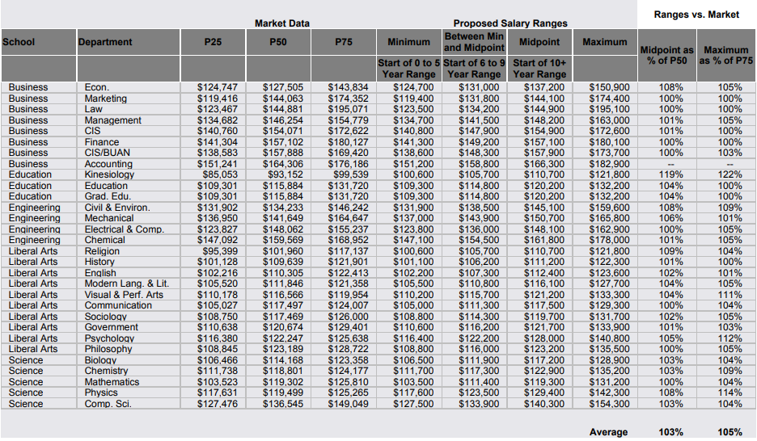
Full Professor Salary Ranges (2016-2017)

Slide 21
Full Professor Salary Ranges: School of Business (2016-2017)
Department | Market Data ($) |  |  | Proposed Salary Ranges ($)
 | 25th percentile | 50th percentile | 75th percentile | Min. (0-5 yrs) | Between Min and Midpoint (6-10 yrs) | Midpoint (10+yrs) | Max.
Economics | 124,747 | 127,505 | 143,834 | 124,700 | 131,000 | 137,200 | 150,900
Marketing | 119,416 | 144,063 | 174,352 | 119,400 | 131,800 | 144,100 | 174,400
Law | 123,467 | 144,881 | 195,071 | 123,500 | 134,200 | 144,900 | 195,100
Management | 134,682 | 146,254 | 154,779 | 134,700 | 141,500 | 148,200 | 163,000
CIS | 140,760 | 154,071 | 172,622 | 140,800 | 147,900 | 154,900 | 172,600
Finance | 141,304 | 157,102 | 180,127 | 141,300 | 149,200 | 157,100 | 180,100
CIS/BUAN | 138,583 | 157,888 | 169,420 | 138,600 | 148,300 | 157,900 | 173,700
Accounting | 151,241 | 164,036 | 176,186 | 151,200 | 158,800 | 166,300 | 182,900

Slide 22
Full Professor Salary Ranges: School of Education (2016-2017)
Department | Market Data ($) |  |  | Proposed Salary Ranges ($)
 | 25th percentile | 50th percentile | 75th percentile | Min. (0-5 yrs) | Between Min and Midpoint (6-10 yrs) | Midpoint (10+yrs) | Max.
Kinesiology | 85,053 | 93,152 | 99,539 | 100,600 | 105,700 | 110,700 | 121,800
Education | 109,301 | 115,884 | 131,720 | 109,300 | 114,800 | 120,200 | 132,200
Grad. Edu. | 109,301 | 115,884 | 131,720 | 109,300 | 114,800 | 120,200 | 132,200

Slide 23
Full Professor Salary Ranges: School of Engineering (2016-2017)
Department | Market Data ($) |  |  | Proposed Salary Ranges ($)
 | 25th percentile | 50th percentile | 75th percentile | Min. (0-5 yrs) | Between Min and Midpoint (6-10 yrs) | Midpoint (10+yrs) | Max.
Civil & Environ. | 131,902 | 134,233 | 146,242 | 131,900 | 138,500 | 145,100 | 159,600
Mechanical | 136,950 | 141,649 | 164,647 | 137,000 | 143,900 | 150,700 | 165,800
Electrical & Comp. | 123,827 | 148,062 | 155,237 | 123,800 | 136,000 | 148,100 | 162,900
Chemical | 147,092 | 159,569 | 168,952 | 147,100 | 154,500 | 161,800 | 178,000

Slide 24
Full Professor Salary Ranges: School of Liberal Arts (2016-2017)
Department | Market Data ($) |  |  | Proposed Salary Ranges ($)
 | 25th percentile | 50th percentile | 75th percentile | Min. (0-5 yrs) | Between Min and Midpoint (6-10 yrs) | Midpoint (10+yrs) | Max.
Religion | 95,399 | 101,960 | 117,137 | 100,600 | 105,700 | 110,700 | 121,800
History | 101,128 | 109,639 | 121,901 | 101,100 | 106,200 | 111,200 | 122,300
English | 102,216 | 110,305 | 122,413 | 102,200 | 107,300 | 112,400 | 123,600
Modern Lang. & Lit. | 105,520 | 111,846 | 121,358 | 105,500 | 110,800 | 116,100 | 127,700
Visual & Perf. Arts | 110,178 | 116,566 | 119,954 | 110,200 | 115,700 | 121,200 | 133,300
Communication | 105,027 | 117,497 | 124,007 | 105,000 | 111,300 | 117,500 | 129,300
Sociology | 108,750 | 117,469 | 126,000 | 108,800 | 114,300 | 119,700 | 131,700
Government | 110,638 | 120,674 | 129,401 | 110,600 | 116,200 | 121,700 | 133,900
Psychology | 116,380 | 122,247 | 125,638 | 116,400 | 122,200 | 128,000 | 140,800
Philosophy | 108,845 | 123,189 | 128,722 | 108,800 | 116,000 | 123,200 | 135,500

Slide 25
Full Professor Salary Ranges: School of Science (2016-2017)
Department | Market Data ($) |  |  | Proposed Salary Ranges ($)
 | 25th percentile | 50th percentile | 75th percentile | Min. (0-5 yrs) | Between Min and Midpoint (6-10 yrs) | Midpoint (10+yrs) | Max.
Biology | 106,466 | 114,168 | 123,358 | 106,500 | 111,900 | 117,200 | 128,900
Chemistry | 111,738 | 118,801 | 124,177 | 111,700 | 117,300 | 122,900 | 135,200
Mathematics | 103,523 | 119,302 | 125,810 | 103,500 | 111,400 | 119,300 | 131,200
Physics | 117,631 | 119,499 | 125,265 | 117,600 | 123,500 | 129,400 | 142,300
Comp. Sci. | 127,476 | 136,545 | 149,049 | 127,500 | 133,900 | 140,300 | 154,300

Slide 26
What’s Next?
Periodic review of the data
Implementation
Next steps

Slide 27
Periodic Review of the Data
The administrative leadership and FWC will update the data annually with a refresh of the CUPA-HR data every three years.
Note: The entire procedure will be evaluated and revised as needed to ensure progress toward these objectives five years after the completion of the adjustments needed to stratify salaries according to time in rank as outlined under implementation.

Slide 28
Implementation
As outlined in the Faculty Welfare Committee’s letter of October 25, 2017, the goals of the process begun by hiring Mercer Consulting and driven by ongoing discussions between the FWC and the College’s administrative leadership team are:
Develop a data-driven, transparent means of determining faculty salaries that takes account of the College’s historical emphasis on fairness but will also facilitate recruitment and retention while addressing compression and inversion in certain schools and departments.
Develop proposals for the CFA to amend the Faculty Handbook to ensure that this contractual document reflects actual practice.

Slide 29
The Next Steps
Step 1
The Faculty Welfare Committee will develop proposals to present to the Council for Faculty Affairs to amend the Faculty Handbook to ensure that this contractual document reflects actual practice.
Step 2
After CFA passage and the agreement of the President, the plan will begin to be implemented 2018-19 contracts.
The salary ranges including 25th percentile, midpoint and 75th percentile for each discipline will be made public.
Each faculty will receive an explanation of the derivation of their salary as well as a timetable setting out when any and all adjustments will be applied.
First, faculty whose salaries are still not at the 25th percentile of their rank and discipline will be raised to that level as soon as possible.
Second, within each discipline, additional adjustments will be made to stratify salaries based on time in rank.
Third, the procedure outlined in objective 2 will be implemented.

Slide 30
Thank you!
If you have any questions, please don’t hesitate to contact FWC members
Co-chairs
Jeff Horn
Kathryn Weld
Members
J. Patrick Abulencia
Amira Annabi
Thom Gencarelli
Shawn Ladda
Bahman Litkouhi
Bruce Shockey

